Slide 1
Pre-Calc & trig
Day 67

Slide 2
From Last Time
page 385 #1-6, 8-9, 10-13, 19-22, 33-34, 47-50, 55, 58, 60, 61, 89

Slide 3
6.5 Solving Square Root and Other Radical Equations
Objective: To solve square root and other radical equations
Radical Equation: an equation that contains radicals √ or rational exponents

Slide 4
Solving Radical Equations: (with one radical)
You need to eliminate the radicals or rational exponents and obtain a polynomial equation
1. Isolate the radical on one side of the equation
2. Raise each side of the equation to the same power
(use inverse of exponent to eliminate radical)
3. Solve and simplify the equation
4. Check solutions in original equation
(not all solutions will be valid)

Slide 5
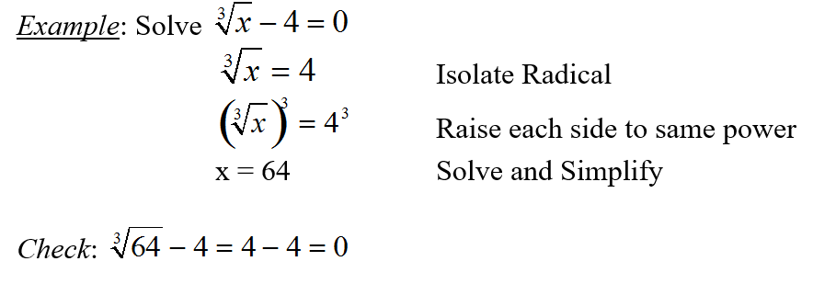

Slide 6
Solving Radical Equations: (with two radicals)
You need to eliminate the radicals or rational exponents and obtain a polynomial equation
1. Rewrite the equation so that each side has only one radical expression
2. Raise each side of the equation to the same power
(use inverse of exponent to eliminate radical)
3. Solve and simplify the equation
4. Check solutions in original equation
(not all solutions will be valid)

Slide 7
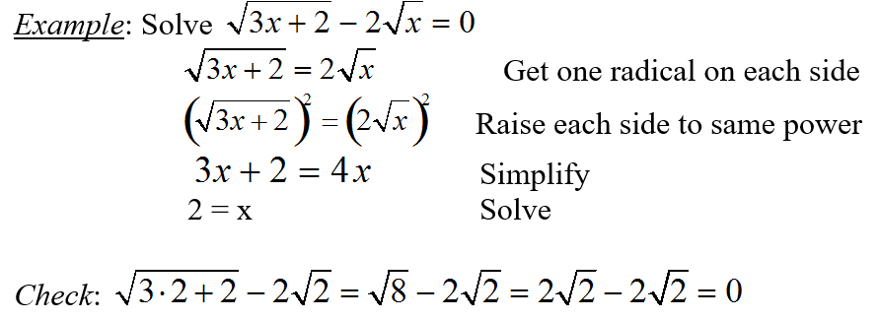

Slide 8

Examples:
$${1.) 5x}^{3}+2=42$$
2.)
3.)
4.) $5x^{2/3}−12=8$

Slide 9

Solutions
1.) ${5x}^{3}=40→x^{3}=8→x=2$
2.) $\sqrt{4x−7}=3→4x−7=9→$ $4x=16→x=4$
3.) $x+4=2x−5→x=9$
4.) $x^{2/3}=4→x=4^{3/2}→x=2^{3}→x=8$

Slide 10
More Examples (if needed)

Slide 11
For Next Time
Page 394 #1-7, 9-39 (odd)

